Slide 1
Building iOS Swift apps
5030-201720_MCS5993_M: 5030-Topics in Computer Science
5031-201720_MCS4993_M: 5031-Topics in MA/CS

Slide 2
Agenda
Xcode intro
Music Venue app
Notes:
Approach for the next few classes is to create a number of small apps to show how to use Xcode

Slide 4
Notes:
Project Navigator

Slide 5
Notes:
Root node – when you click on the blue project folder

Slide 6
Notes:
Search navigator

Slide 7
Notes:
Issue Navigator – when your code has problems

Slide 8
Notes:
Code Editor area

Slide 9
Notes:
Interface builder view

Slide 10
Notes:
Breakpoint Gutter

Slide 11
Notes:
Utility Area
The Inspector pane will give you details about the file you’ve got highlighted in your project navigator. However, when you’re looking at a XIB/StoryBoard file, the inspector pane will show you the different attributes that you can modify for a selected element.

Slide 12
Notes:
The Inspector pane will give you details about the file you’ve got highlighted in your project navigator. However, when you’re looking at a XIB/StoryBoard file, the inspector pane will show you the different attributes that you can modify for a selected element.

Slide 13
Notes:
The debug area will show you console output and the state of various variables when you run your application.
You’ll be using this a lot while debugging your code and trying to figure out why things aren’t working out the way you expect them to! I’ll need to write a separate XCode debugger tutorial because there’s too much to mention here.

Slide 14
Notes:
Toolbar –
The left-most button is the run button. This will build and run your application and launch your app in the iOS Simulator. The button beside it will stop the execution of your application and return you to Xcode.
Test to run your unit tests if you have them in your project.
Profile to measure various aspects of your application such as performance, memory usage and more.
Analyze to let Xcode analyze your code and check for potential leaks or bad practices.

Slide 15
Notes:
The dropdown beside the Stop button indicates which build target you want to run (your can run an Apple Watch target too) and you can also choose if you want to run it under the iPhone or iPad simulators (or different version if you have them installed). The selection “iOS device” is to run your app on your device if you have it plugged in and properly provisioned (which needs a whole tutorial in itself!).

Slide 16
Notes:
You can actually do a lot with the simulator including: -Device rotation -Simulating various GPS coordinates -Device shake -Simulating low memory scenarios

Slide 17
Agenda
Xcode intro
Music Venue app
Notes:
Approach for the next few classes is to create a number of small apps to show how to use Xcode

Slide 18
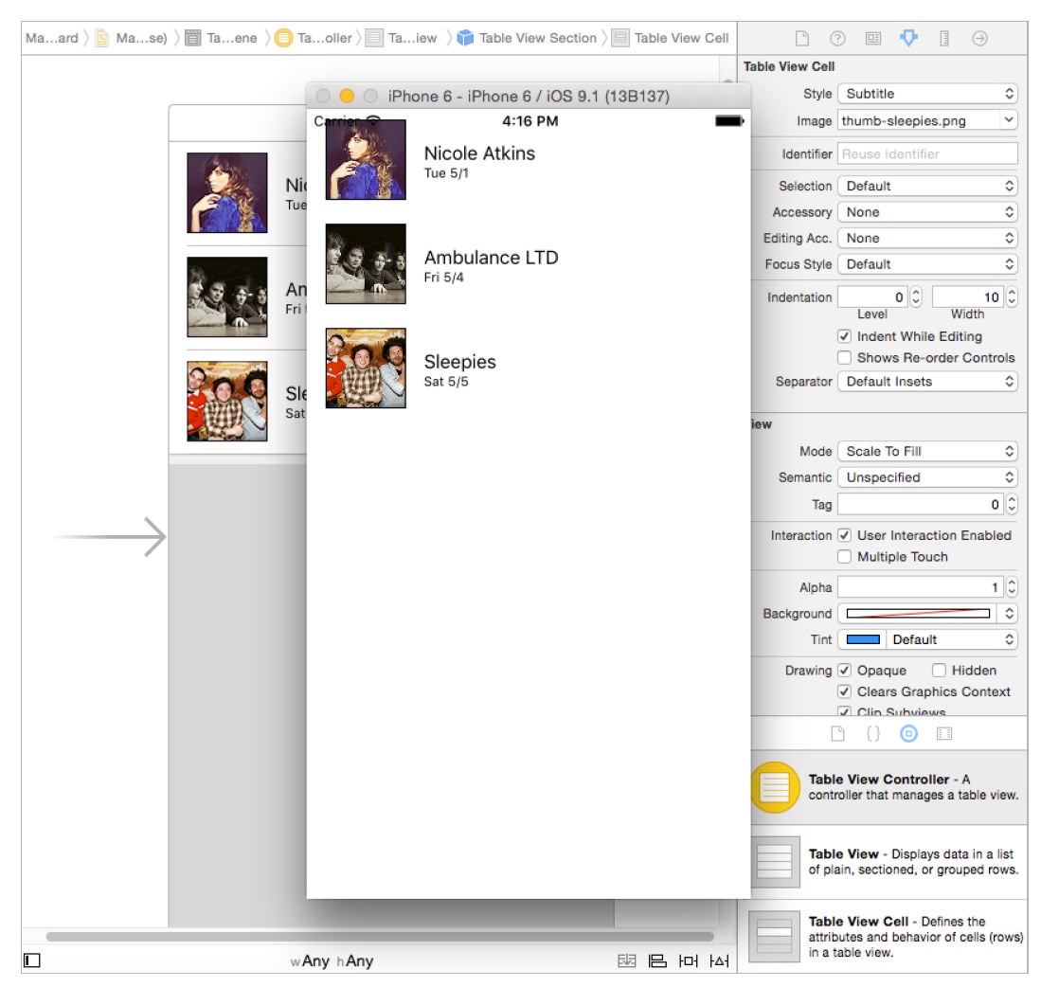

Slide 19
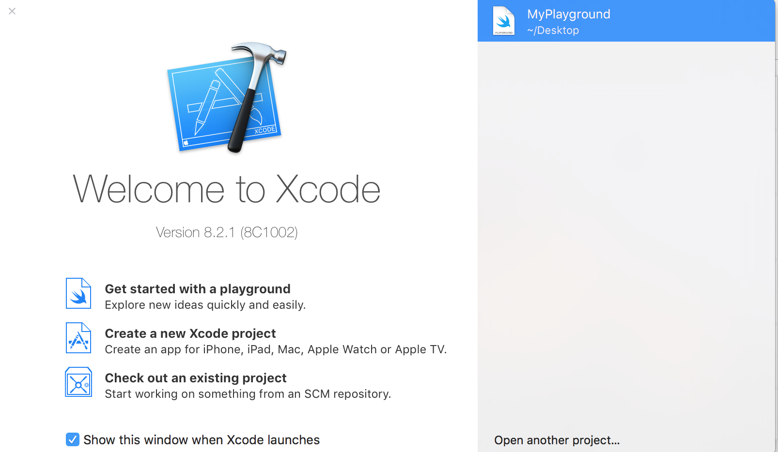
Getting Started
Notes:
Choose Create a new Xcode project

Slide 20
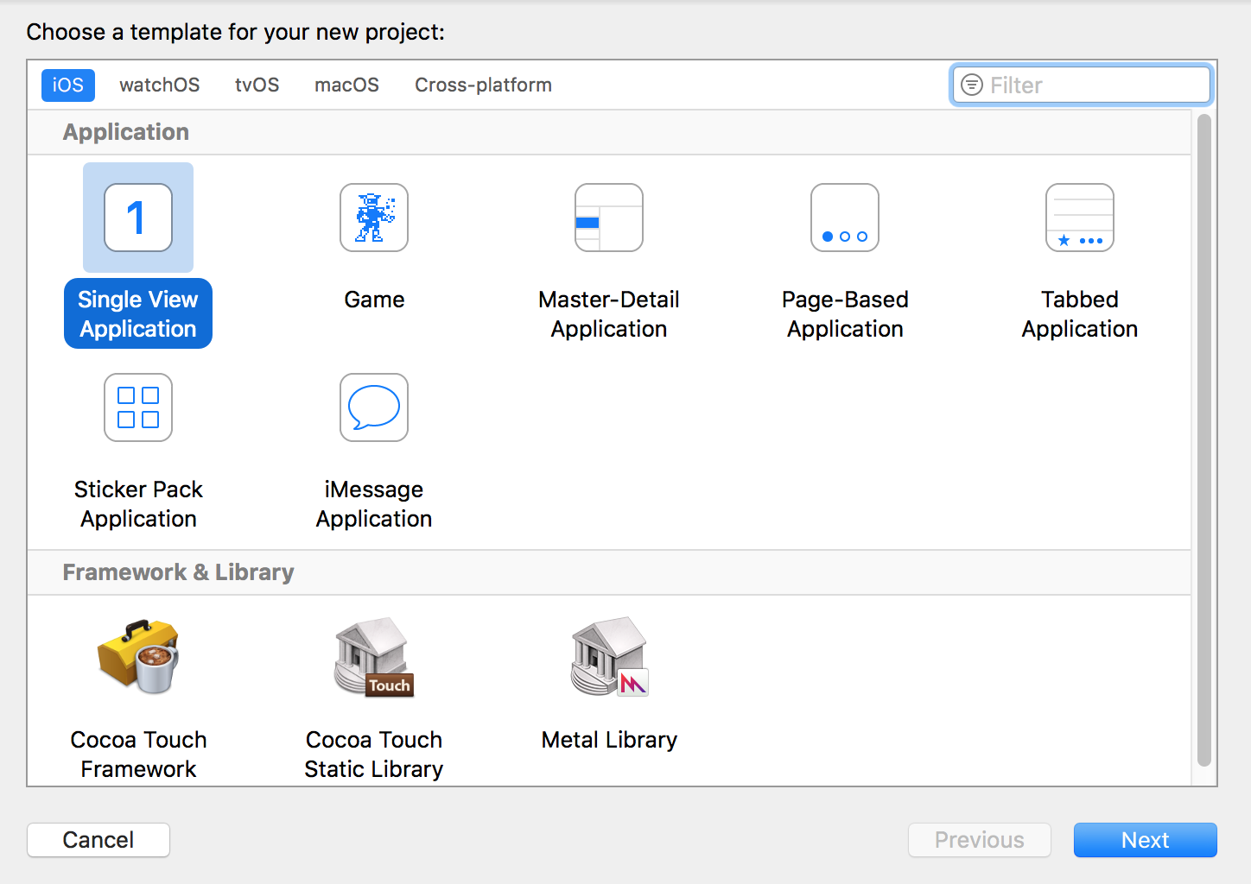
Getting Started
Notes:
Click on a Single View Application
We’ll make it a master detail in the future but for the moment it’ll be Single View

Slide 21
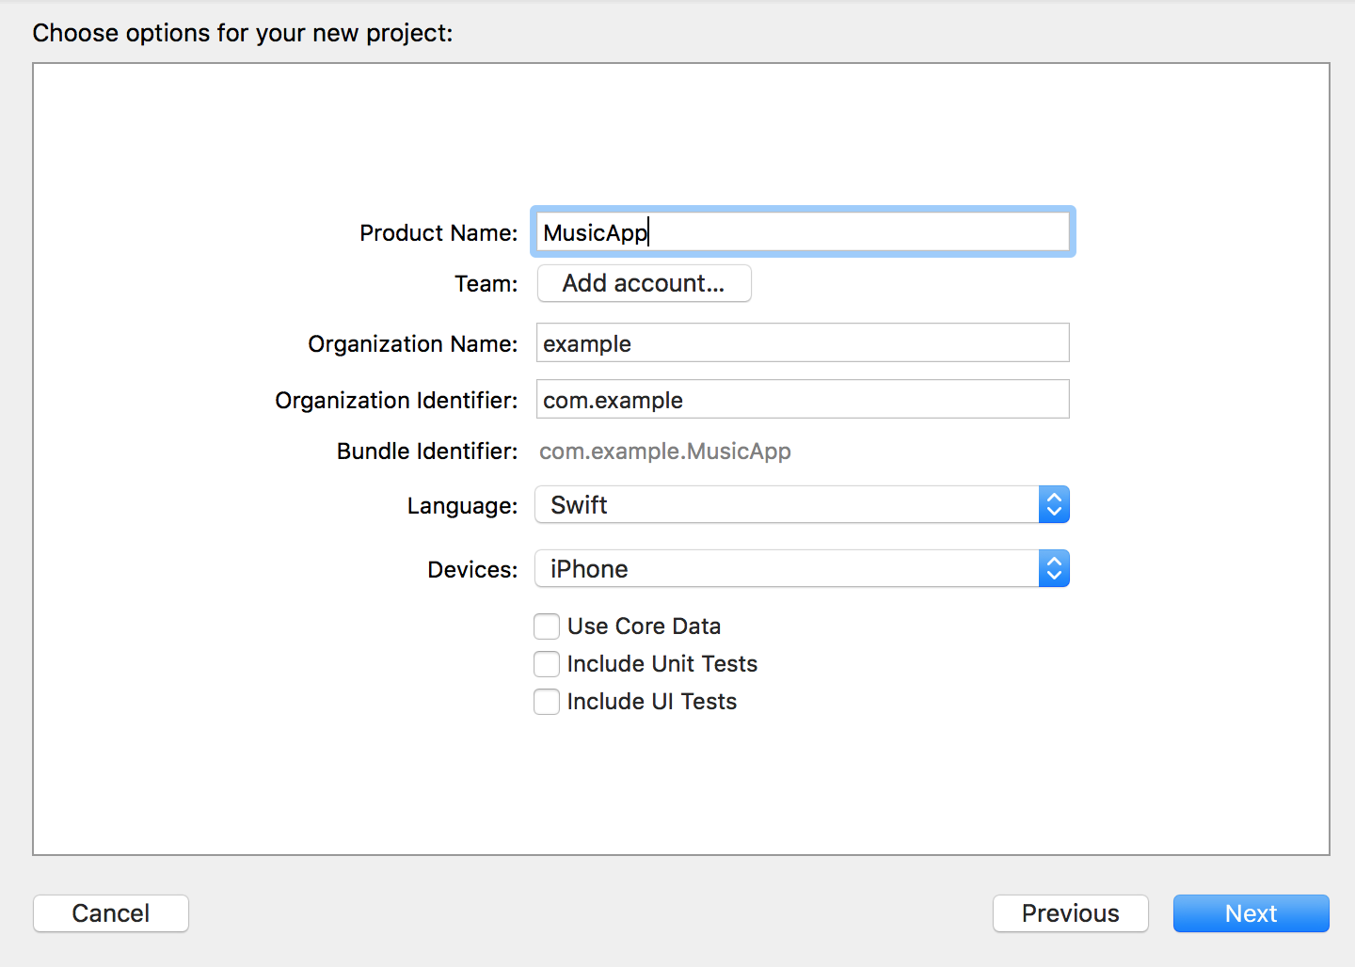
Getting Started
Notes:
Set the following:
• Product Name: MusicApp
• Language: Swift
• Devices: iPhone
Click Next.

Slide 22
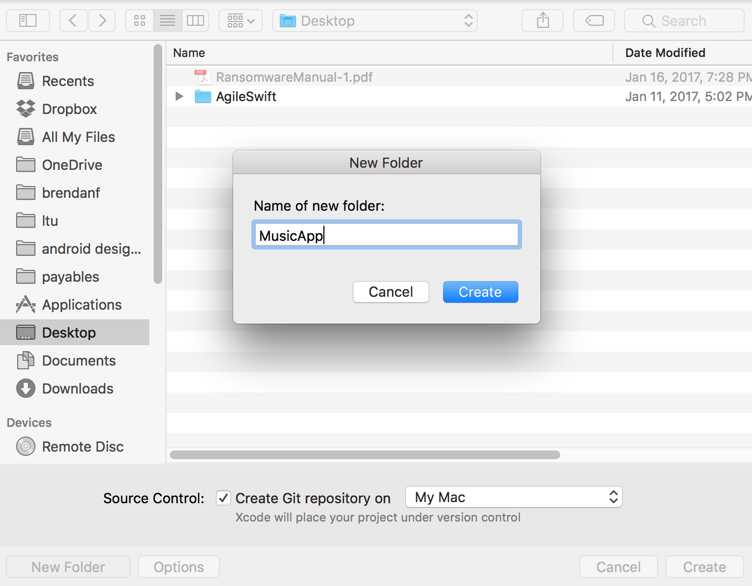
Notes:
Click new folder
Enter MusicApp and click create
Check Create Git repository on My Mac if it is not already checked.
Click Create.

Slide 23
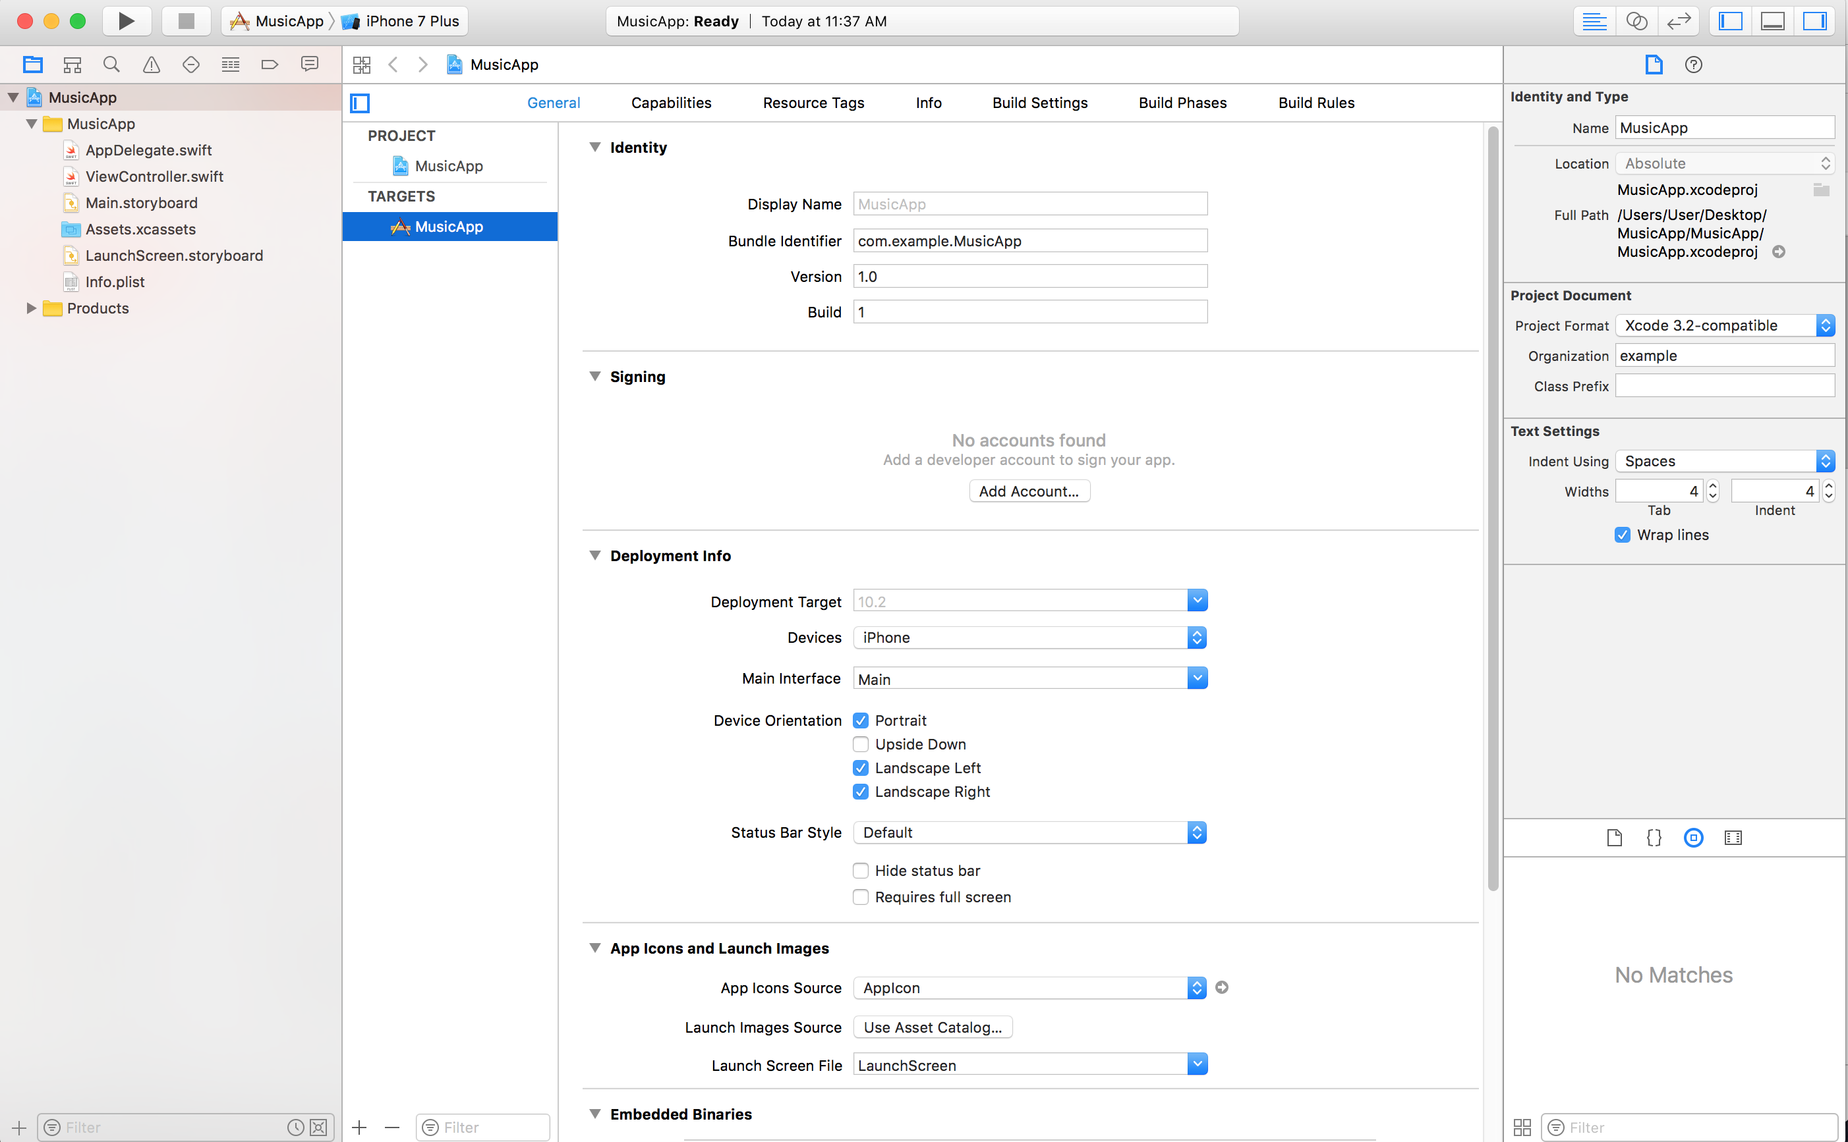
Notes:
We’re at the root node and we can see the identity, signing, deployment info etc.
In the Project Navigator, in the musicapp folder notice that a few files were created automatically.
Because we chose Single View Application when creating this project, Xcode automatically created a View Controller as well as an AppDelegate.swift file.
Click on Main.storyboard.

Slide 24
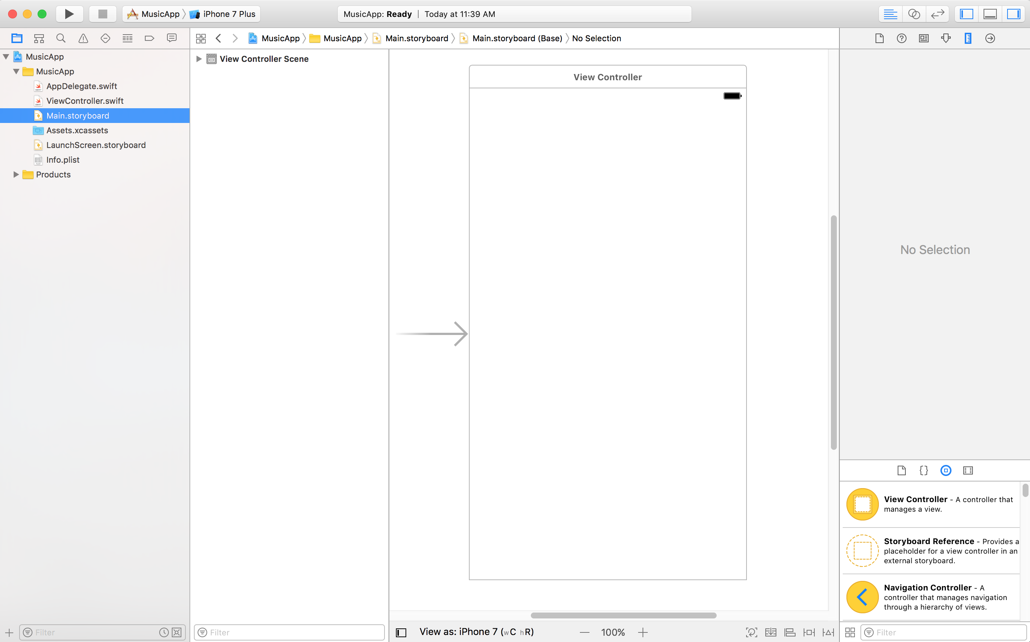
Notes:
Make sure the Document Outline is showing. If you don’t see it, click the Show Document Outline button at the bottom left of the Editor area.
In the Document Outline, expand View Controller Scene then click on View Controller to select it.
We want more functionality than what the default View Controller provides. Let’s replace it with a Table View Controller.
With the View Controller still selected, hit Delete.

Slide 25
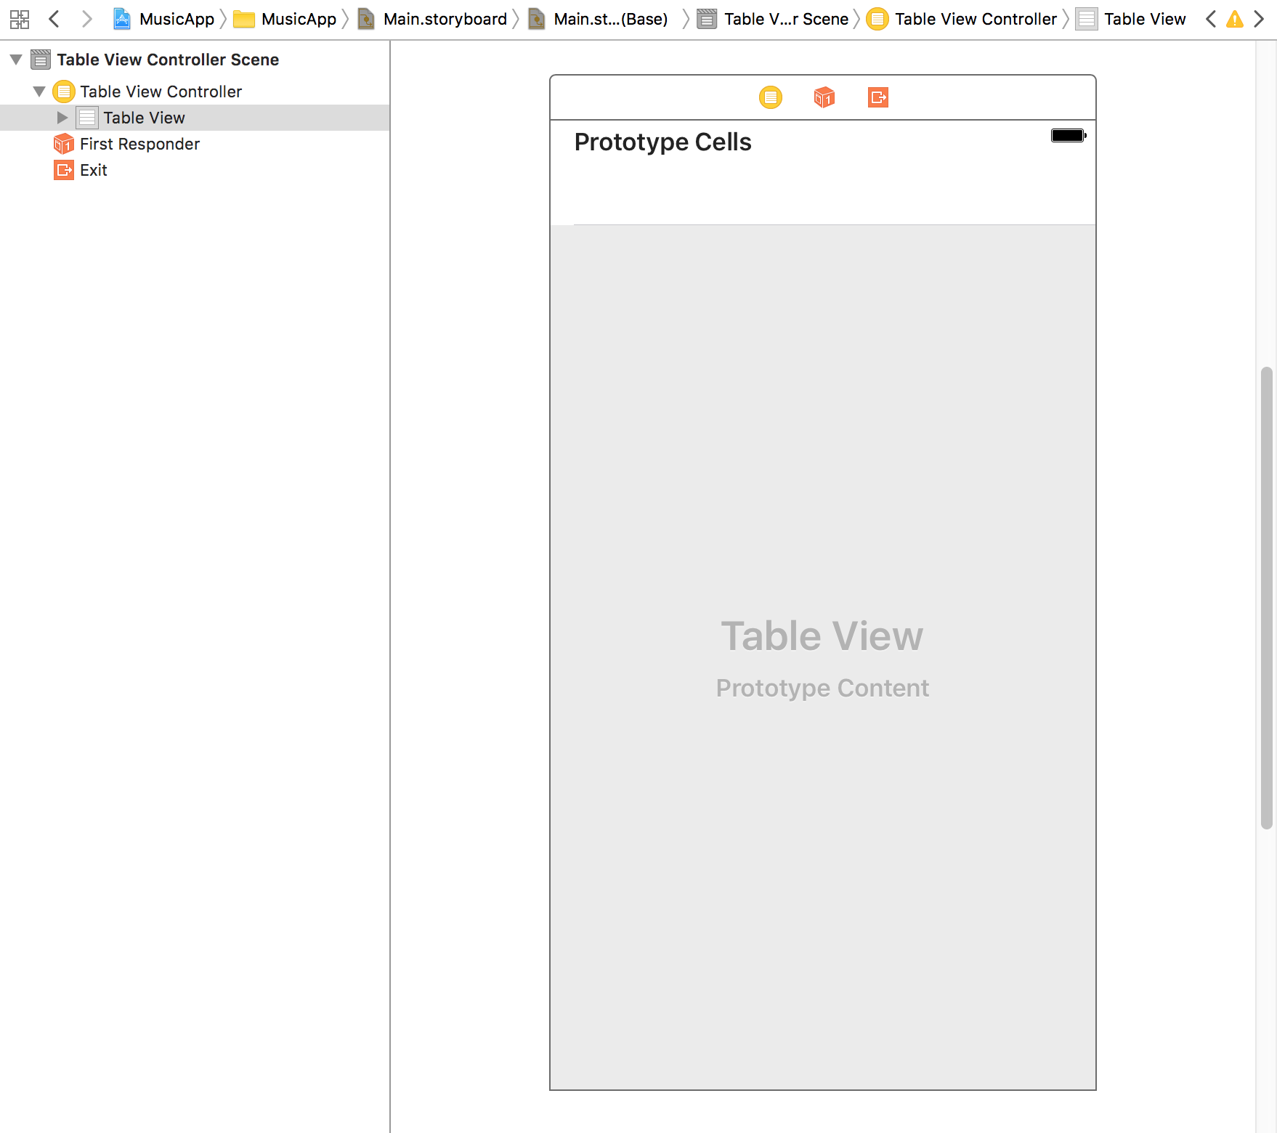
Notes:
At the bottom right of the window, in the Object library , find the Table View Controller object.
Drag the Table View Controller onto the Editor.
In the Document Outline, select Table View Controller.
In the Attributes inspector , under View Controller, check on Is Initial View Controller.
This specifies the Storyboard Entry Point, which disappeared when we deleted the first View Controller.

Slide 26
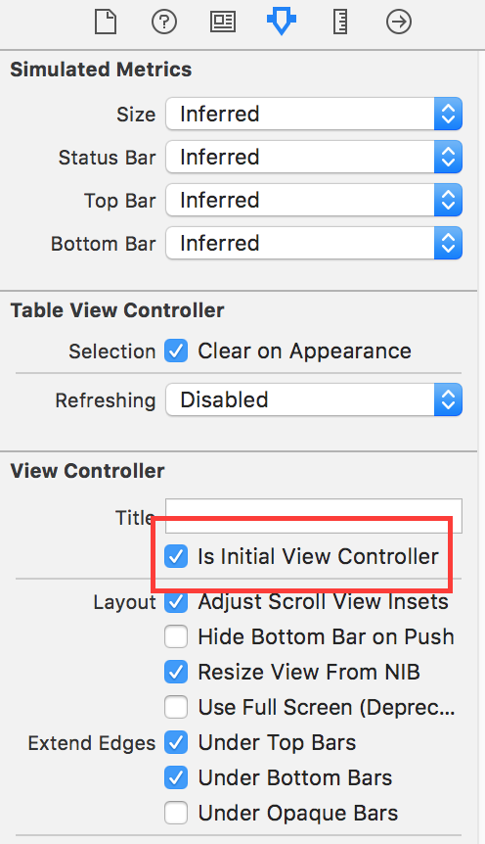
Notes:
In the Attributes inspector under View Controller, check on Is Initial View Controller.
This specifies the Storyboard Entry Point, which disappeared when we deleted the first View Controller.

Slide 27
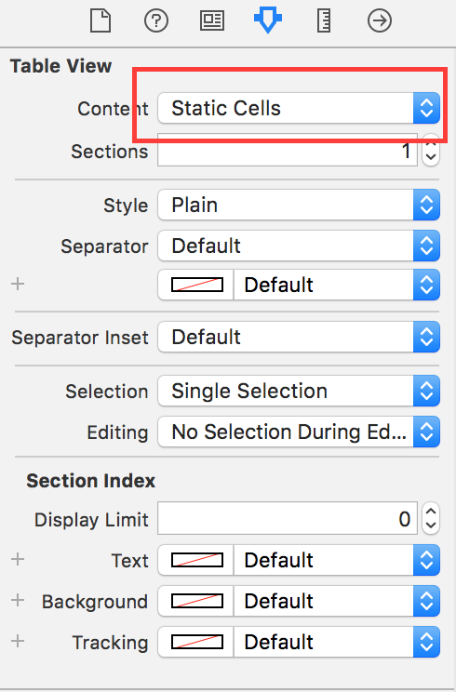
Adding Cells
Notes:
1. In the Document Outline, expand Table View Controller if it is not already expanded.
2. Click on Table View.
3. In the Utilities area on the right, go to the Attributes inspector tab .
4. Under Table View, from the Content menu, choose Static Cells.
NOTE: In a later exercise we’ll show you how to create Dynamic Prototype cells
using code. In this exercise, we just want to mock up what this View Controller will
look like, so we’ll use Static Cells for now.

Slide 28
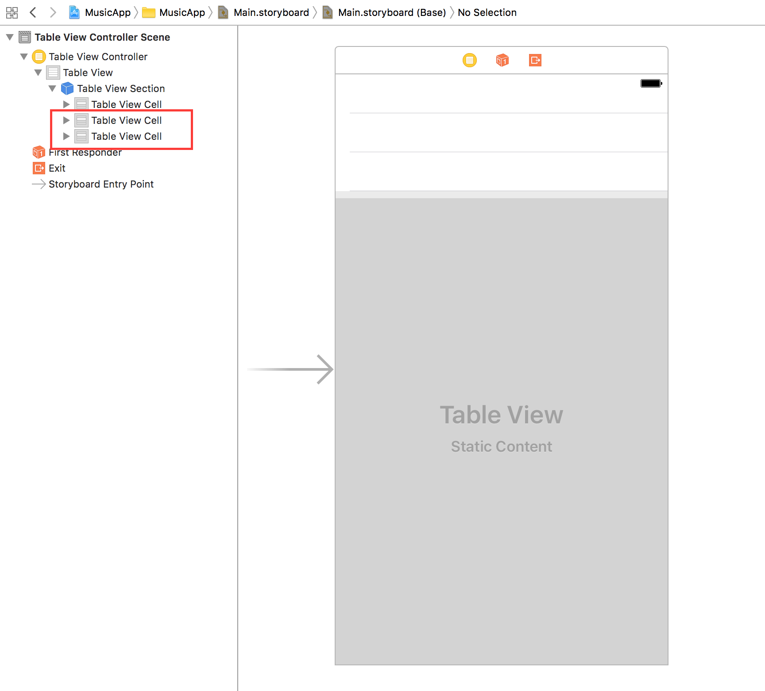
Adding Cells
Notes:
5. In the Document Outline, expand Table View.
6. Expand Table View Section.
7. Notice there are three Table View Cells listed. Right now we only want to work with
one, which we’ll make copies of later, so let’s delete the two extra Table View Cells.
Click on the second Table View Cell to select it.
8. Hold Shift and click on the last Table View Cell to select them both.
9. Hit Delete.
10. Click the remaining Table View Cell to select it.
11. In the Attributes inspector , set the Style menu to Subtitle.
12. In the Document Outline, expand Table View Cell then expand Content View.
13. Notice there are two labels: Title and Subtitle. Click on Title.

Slide 29
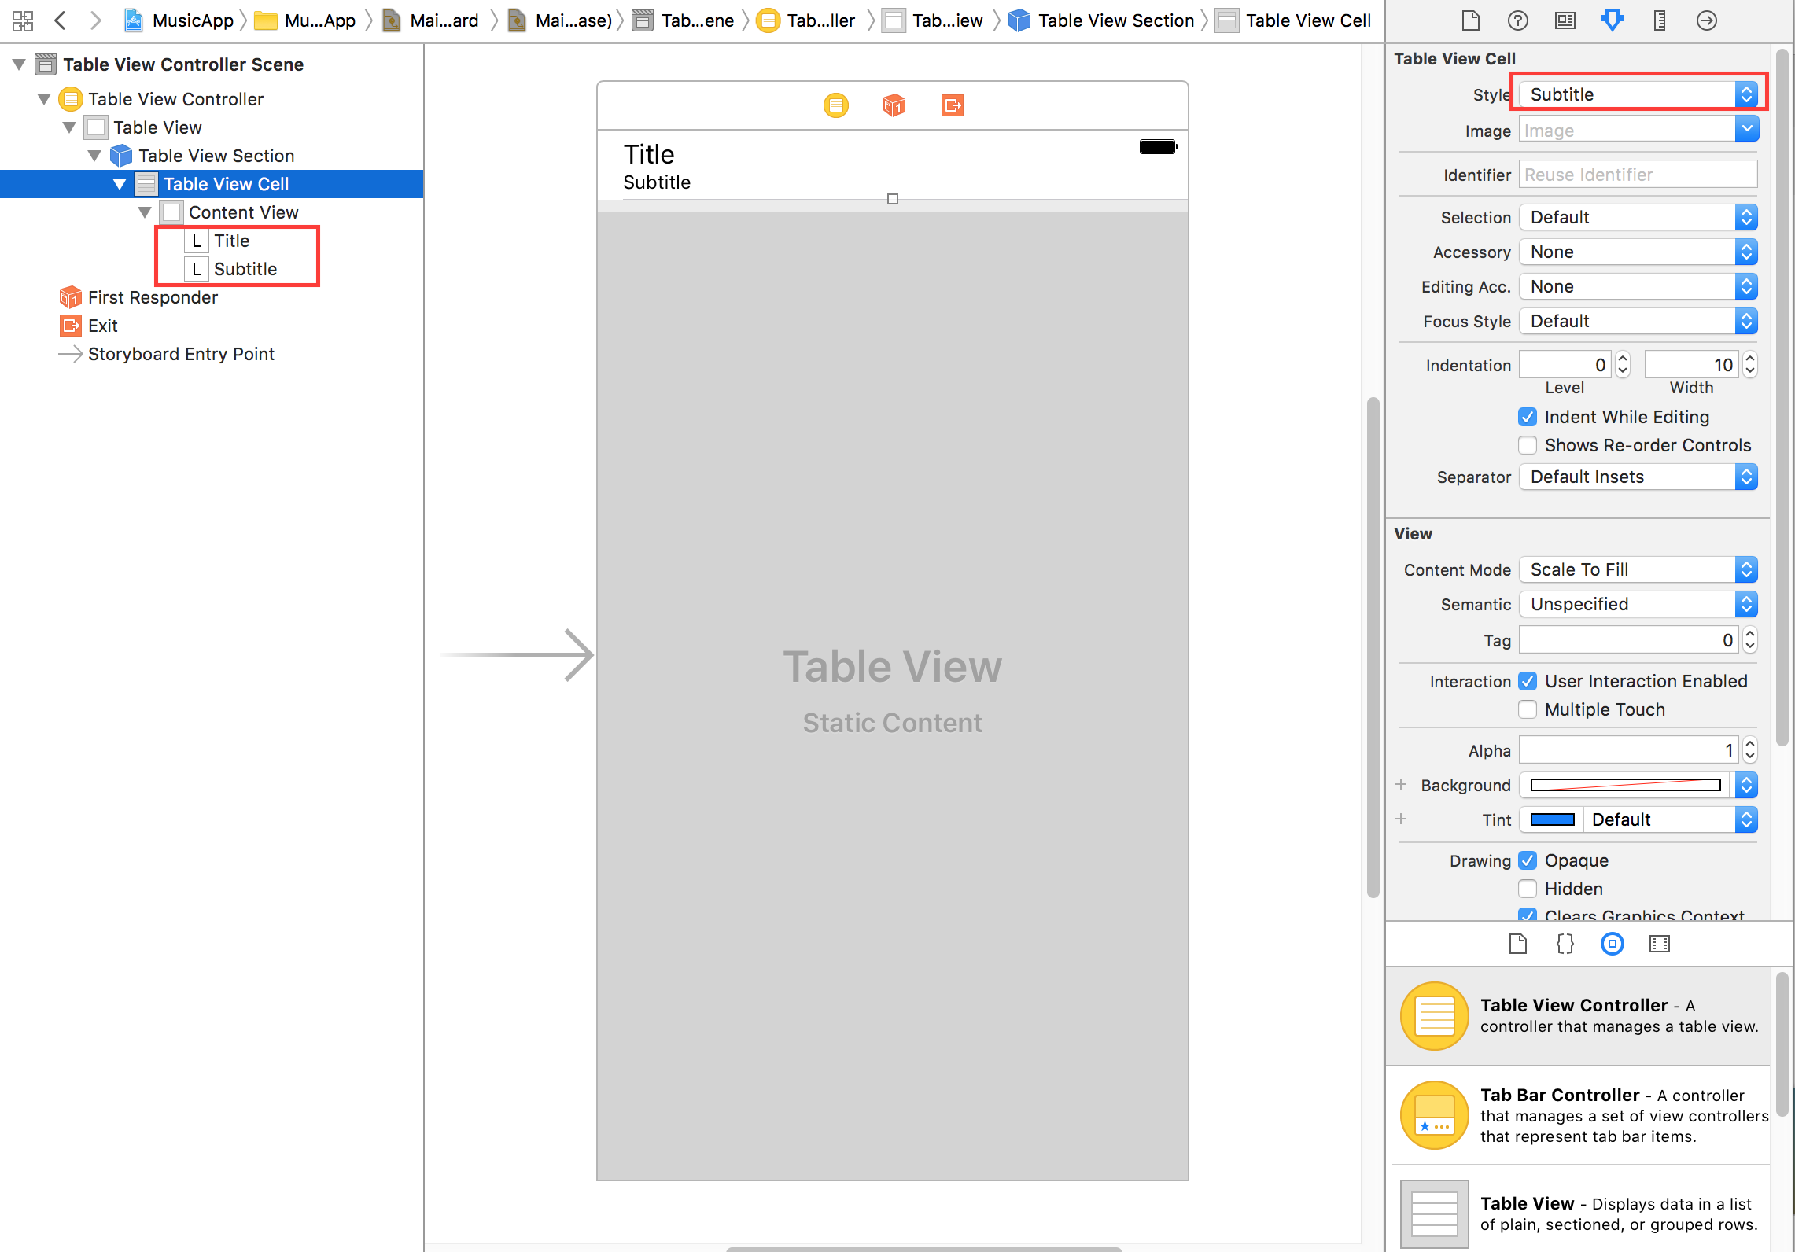
Notes:
10. Click the remaining Table View Cell to select it.
11. In the Attributes inspector , set the Style menu to Subtitle.
12. In the Document Outline, expand Table View Cell then expand Content View.
13. Notice there are two labels: Title and Subtitle. Click on Title.

Slide 30
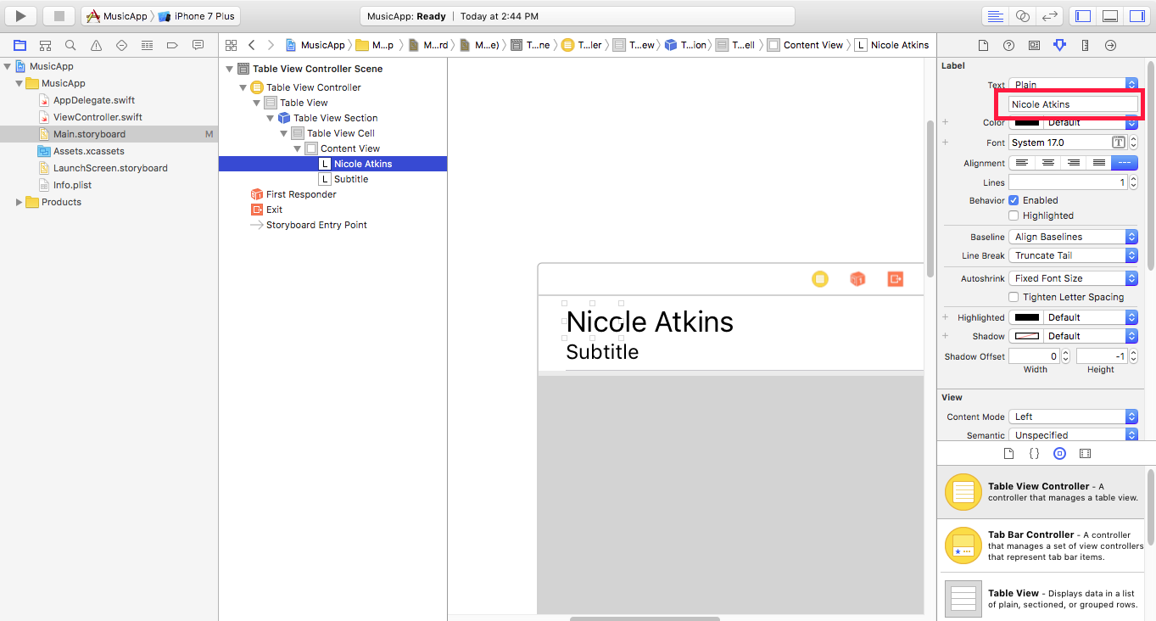
Notes:
In the Attributes inspector , below the Text menu in the field that currently says
Title, delete the text and change it to: Nicole Atkins
NOTE: Xcode is finicky sometimes, so you will not be able to see the entire text now.
We will fix it soon—the text will fully display once we add an image.
15. Click on Subtitle.
16. Underneath the Text menu in the field that currently says Subtitle, change it to:
Tue 5/1

Slide 31
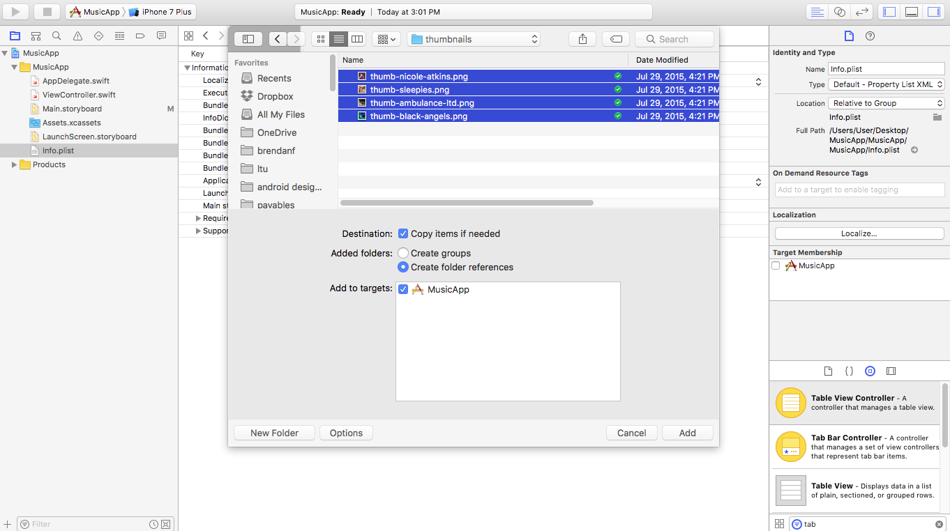
Notes:
We want to add an image of the band to the cell. First we need to add the imageswe will be using to our project.
In the Project Navigator, click on Info.plist. We want the images to be added afterthis file.
2. Go to File > Add Files to “Jive Factory”.
3. Navigate into: Desktop > Class Files > yourname-iOS Dev Level 2 Class > Band
Images > thumbnails > regular
4. Press Cmd–A to select all the images in that folder.
5. At the bottom of the window, click Options, then set the following:
• Destination: Check Copy items if needed
• Added folders: No folders are being added, so leave as is.
• Add to targets: Check on Jive Factory.
6. Click the Add button.

Slide 32
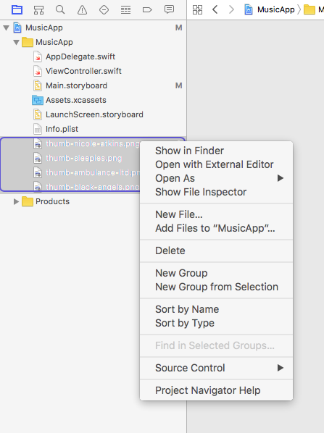
Notes:
7. In the Project Navigator, notice the files have been added below Info.plist.
Let’s make sure our files stay organized by putting the images into their own folder.
8. Click the first image in the Project Navigator, then Shift–click the last image. (You
should have four selected.)
9. Ctrl–click or Right–click on any of the images, and from the menu, choose
New Group from Selection.
10. Replace the New Group folder name with Images and hit Return.

Slide 33
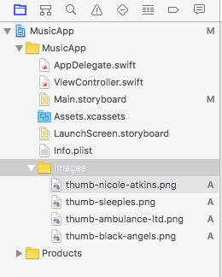
Notes:
11. Expand the Images folder to see the four PNG files inside.

Slide 34
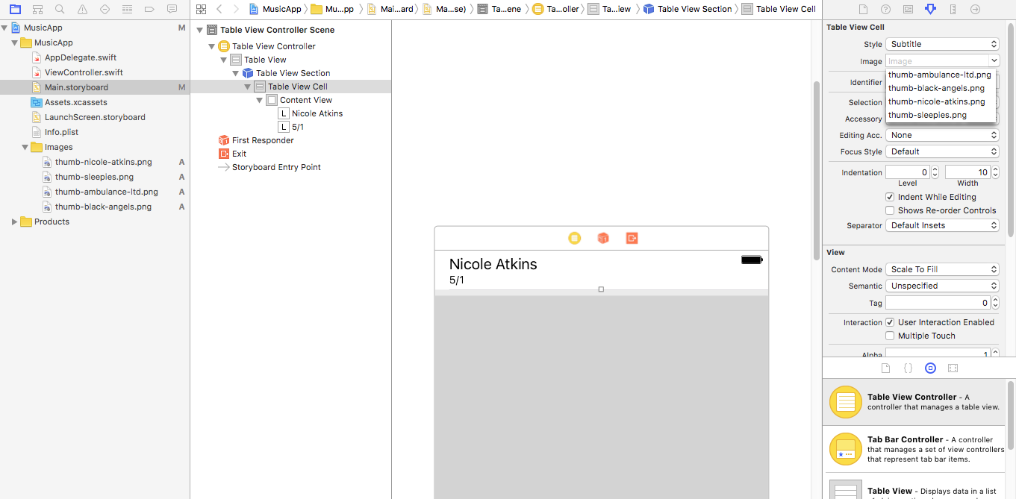
Notes:
12. Click on Main.storyboard.
13. Now we’ll add an image to the Table View Cell. In the Document Outline, click on Table View Cell.
14. In the Attributes inspector , from the Image menu, choose thumb-nicoleatkins. png as shown below.

Slide 35
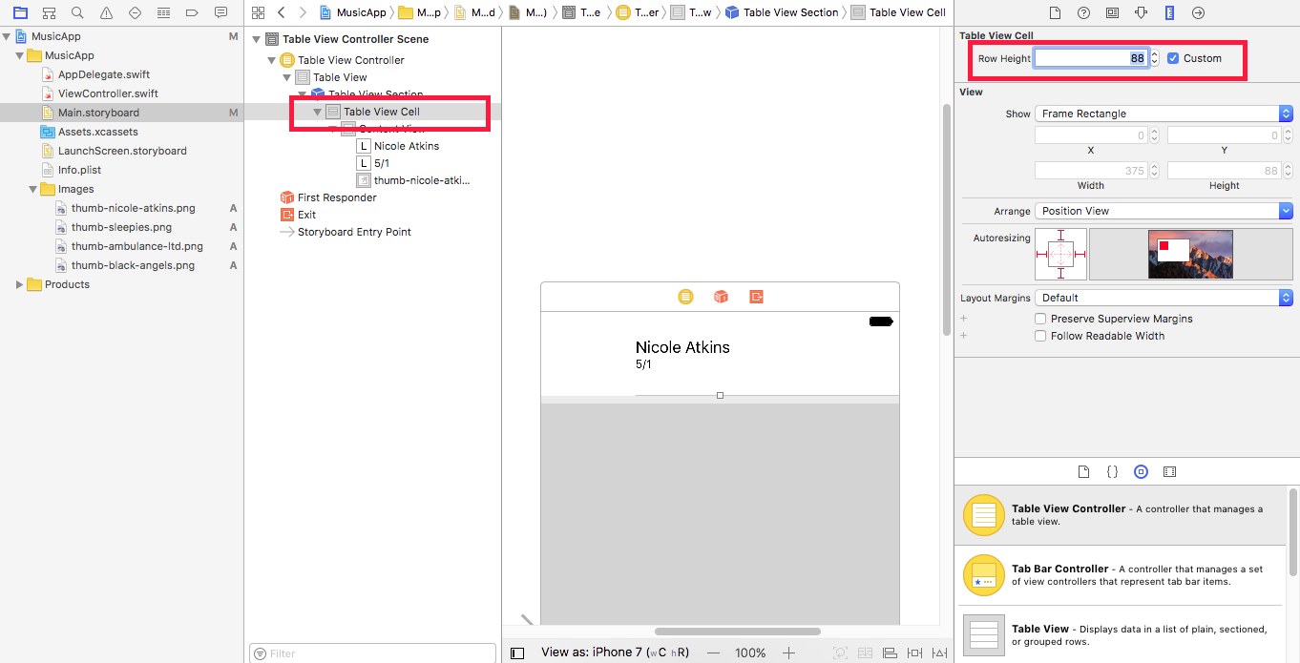
Notes:
In the Editor, notice the thumbnail image has been added next to the title. It’s a little
smaller than it should be. Right now it’s being resized because the cell isn’t tall
enough. Let’s make the cell taller.
16. In the Utilities area on the right, click the Size inspector tab .
17. Next to Row Height, enter 88 and press Return.
18. In the Editor, notice the improved look of our cell. Awesome!

Slide 36

Notes:
notice the improved look of our cell. Awesome!

Slide 37
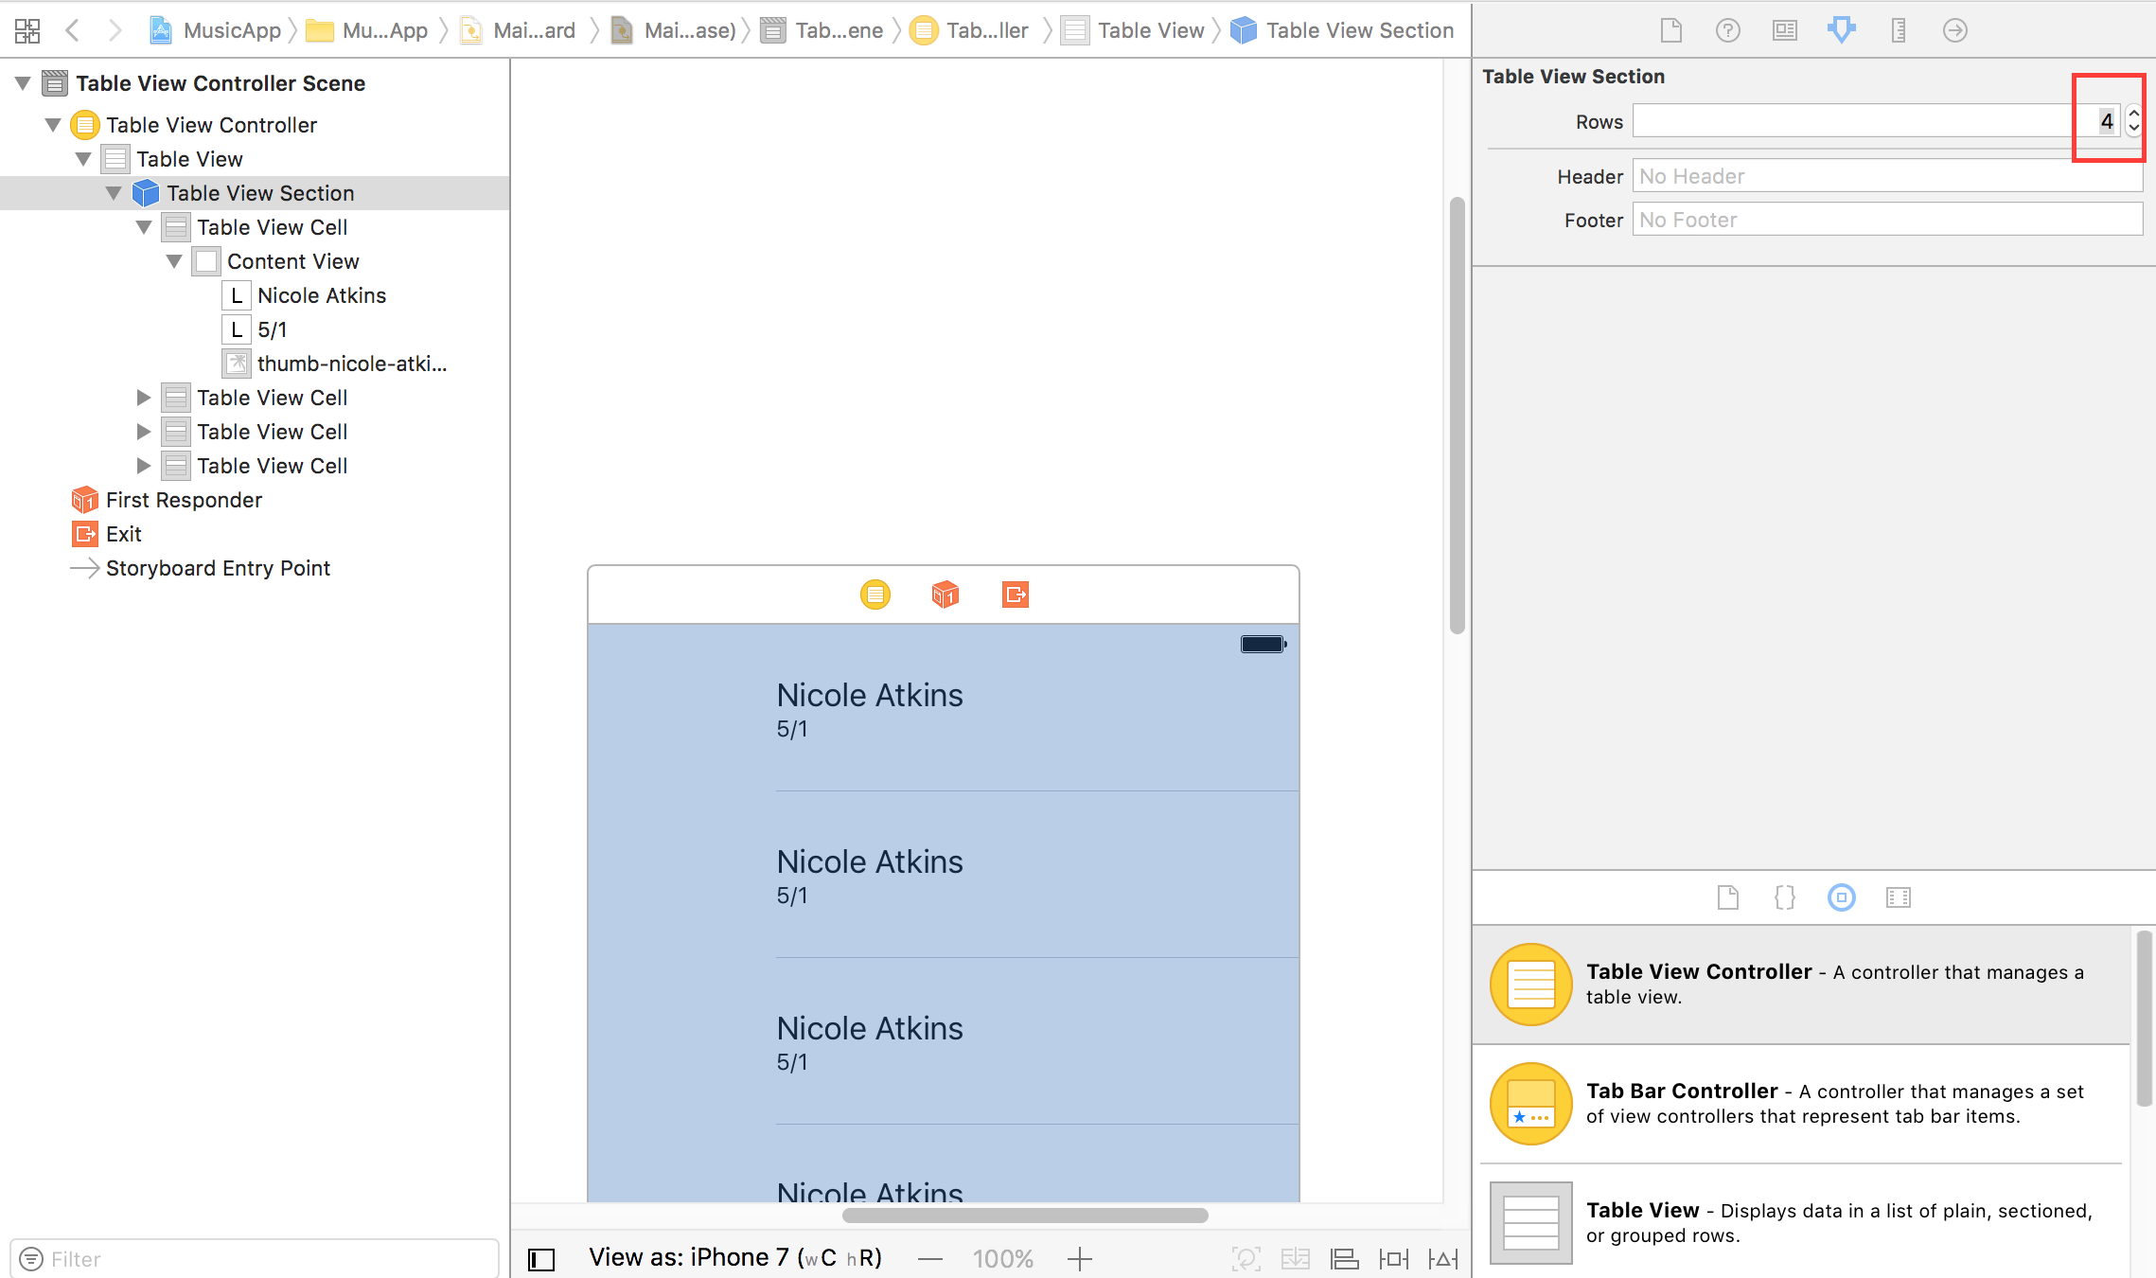
Notes:
1. In the Document Outline, click on Table View Section.
2. In the Utilities area on the right, click the Attributes inspector tab .
3. Next to Rows change 1 to 4 and hit Return.
Voila! We now have four copies of the
original cell in the Editor!

Slide 38
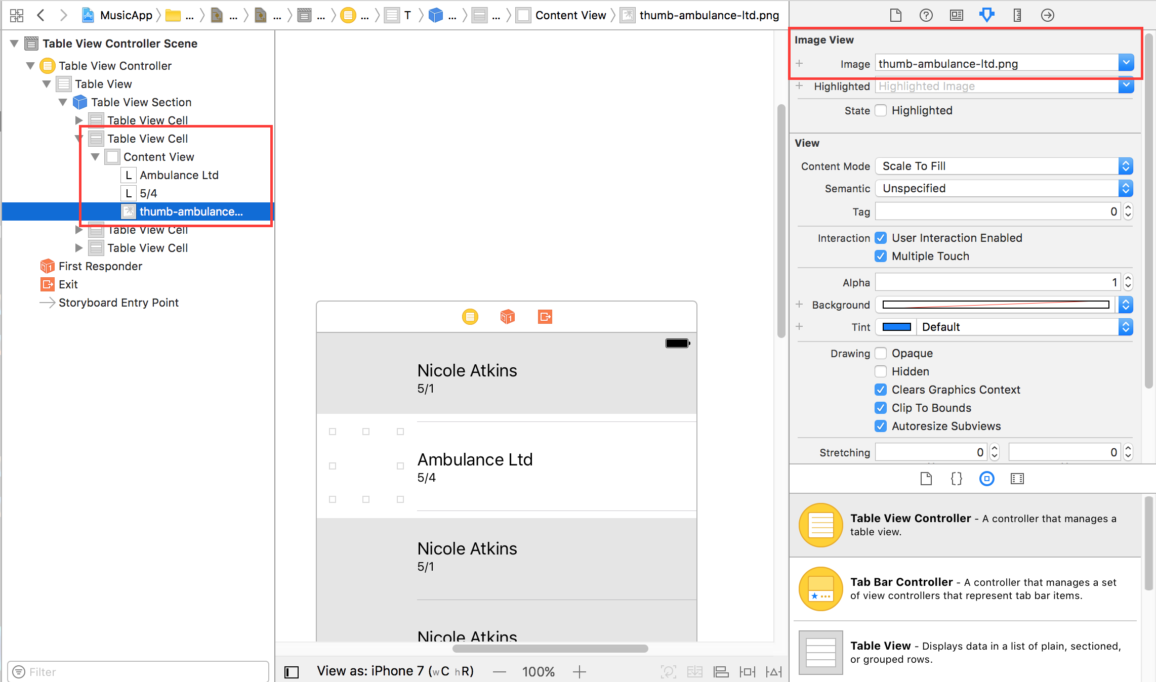
Notes:
4. In the Editor, click on the second Nicole Atkins cell.
5. In the Attributes inspector , from the Image menu, choose thumb-ambulanceltd.png.
6. In the Editor, notice the image changed in the second cell.
7. Double–click the Nicole Atkins text in the second cell and change it to: Ambulance LTD
8. Double–click the Tue 5/1 text below that and change it to: Fri 5/4

Slide 39
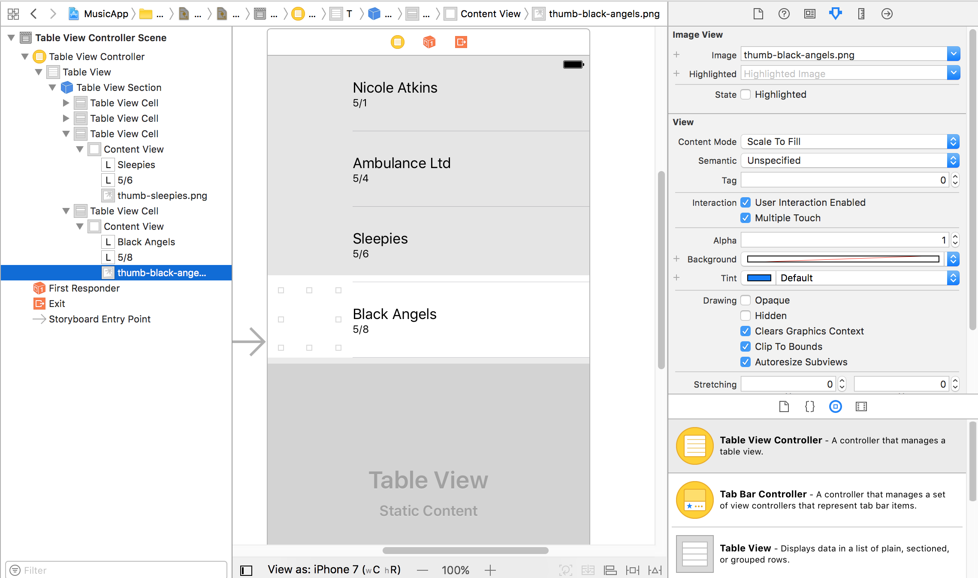
Notes:
Edit the third and fourth cells for the remaining bands,
Sleepies and Black Angels using the details below:
Band Date Image Filename Sleepies Sat 5/5 thumb-sleepies.png
Black Angels Sun 5/6 thumb-black-angels.png

Slide 40
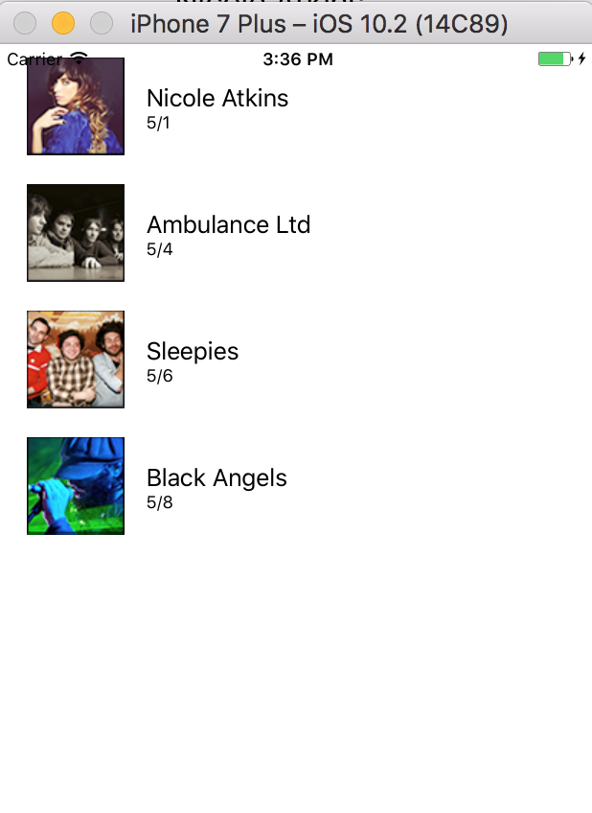
Notes:
10. Let’s preview our work so far. Set the active scheme (top-left corner) to
Jive Factory > iPhone 6.
11. Click the Run button. The Simulator may take a while to load. After it loads, you
won’t be able to do anything in the app, but you can see the layout

Slide 41
Agenda
Assignment – Exercism Word Count
Assignment – List of features in project
Tuesday - Table View Controller, Navigation Controller

